Slide 1

NHS Sheffield Clinical Commissioning Group
Dr Tim Moorhead
Chair of the CCG

Slide 2
Welcome to our first
Annual General Meeting
Who we are
Purpose of the Annual General Meeting
Agenda

Slide 3
Our First Year
Our aims taken from our Prospectus:
      To improve patient experience and access to care
      To improve the quality and equality of healthcare in Sheffield
      To work with Sheffield City Council to continue to reduce health inequalities in Sheffield
      To ensure there is a sustainable, affordable healthcare system in Sheffield
Setting up a new clinically focused organisation with no legal restrictions to deliver our key aims

Slide 4
Key Milestones
April 1st - Launch of CCG – fully compliant with the law
Our first commissioning plan
  Musculoskeletal Services
  Urgent Care (Primary Care Centre/111)
  Integrating Health and Social Care
  Improved Elective Pathways – designed by clinicians for patients
  Care Planning within Primary Care
  Right First Time
  “Involve Me” - engage with us

Slide 5
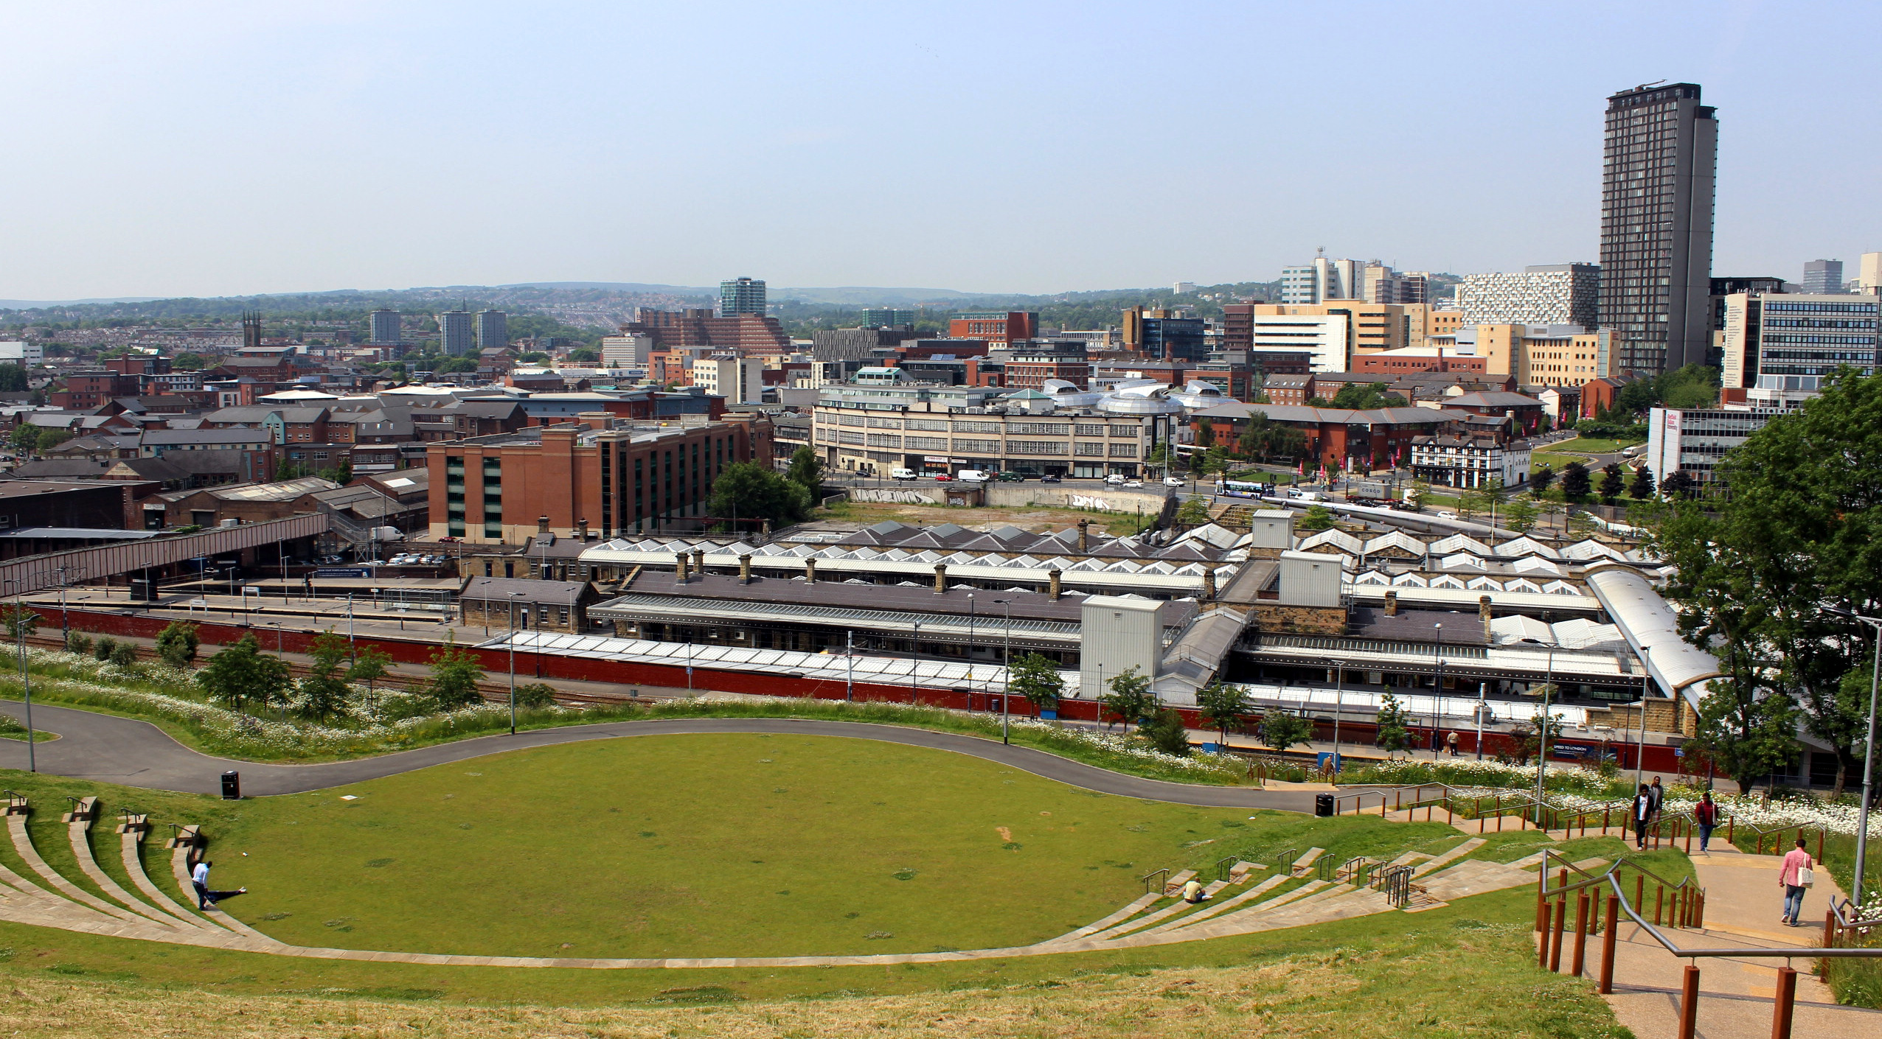
Media coverage – Sheffield Star
GPs handed £700m in first step of NHS reform
FAMILY doctors have been handed control of a major chunk of
Sheffield’s £1 billion NHS budget as health bosses enact the first
stage of the Government’s controversial health reforms.
A small group of eight GPs, a nurse, four lay members and three
officials have taken over responsibility for £709 million – 71 per
cent – of the city’s health commissioning budget.
The money is used for all hospital, ambulance and mental health services.
The Government’s proposals to end the role of the existing Primary Care Trusts and give the budgets to GPs sitting on new Clinical Commissioning Groups have not yet passed through Parliament – and, if they do, the change will not take place until the end of March 2013.
December 2011

Slide 6
Media coverage – Health Service Journal
April 2014

Slide 7
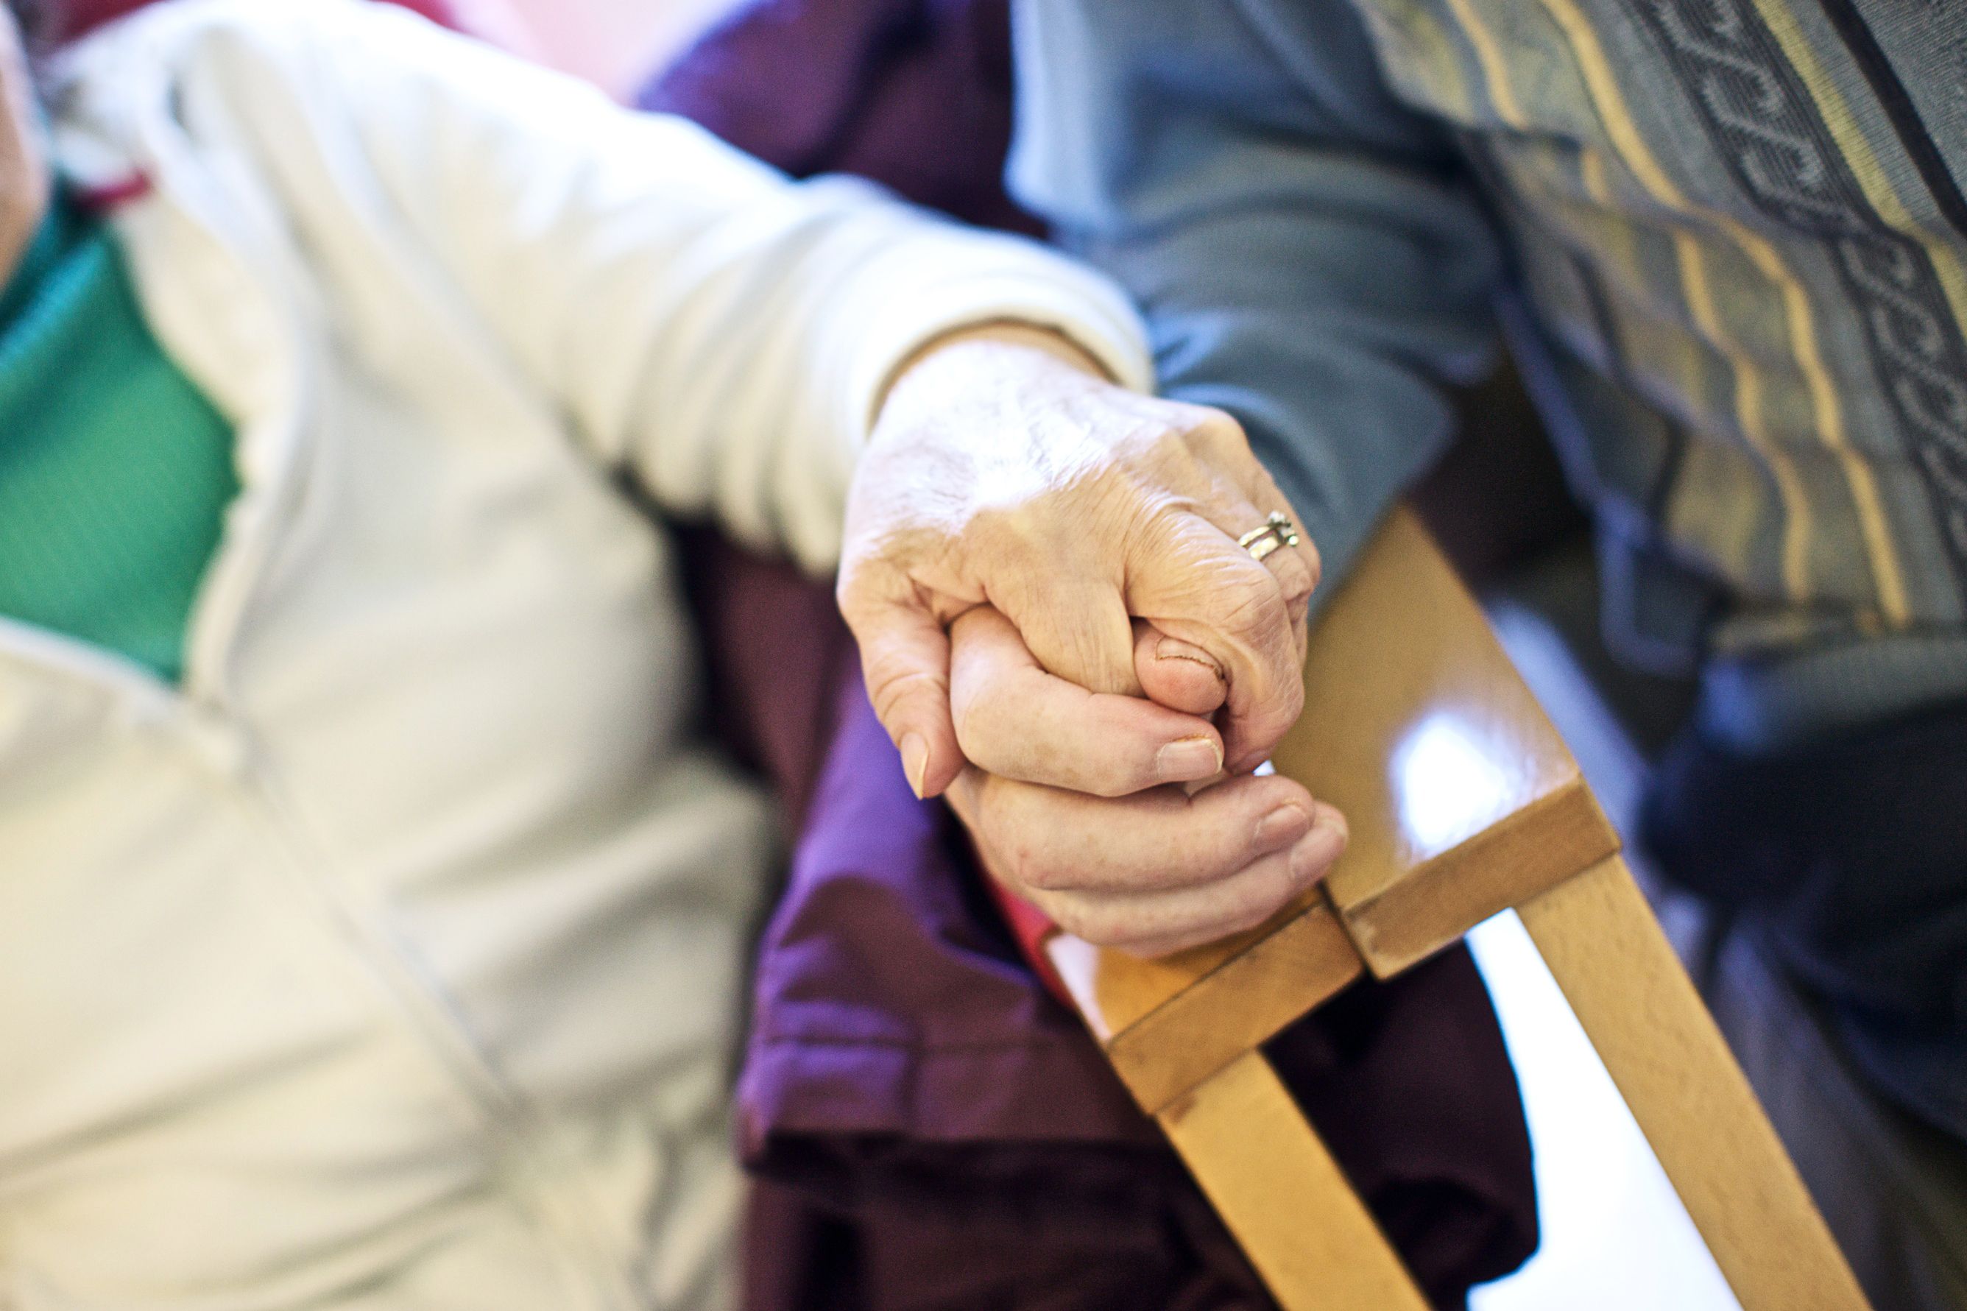
Media coverage – Sheffield Star
Chance to shape Sheffield’s mental health services
The chance to shape mental health service provision
in Sheffield is on offer to care users and professionals
in the city.
NHS Sheffield Clinical Commissioning Group is
asking those with three years or more experience of
mental health services - either as a carer or care user –
to help inform ‘strategic plans’ and ensure future services are meeting the area’s needs.
Those selected will be asked to attend meetings of the Mental Health Partnership Board. A statement released by the board said: “The Sheffield health and wellbeing community are keen to ensure that people with experience of using mental health services directly, and those who care for them, help to inform our strategic plans.”
May 2014

Slide 8
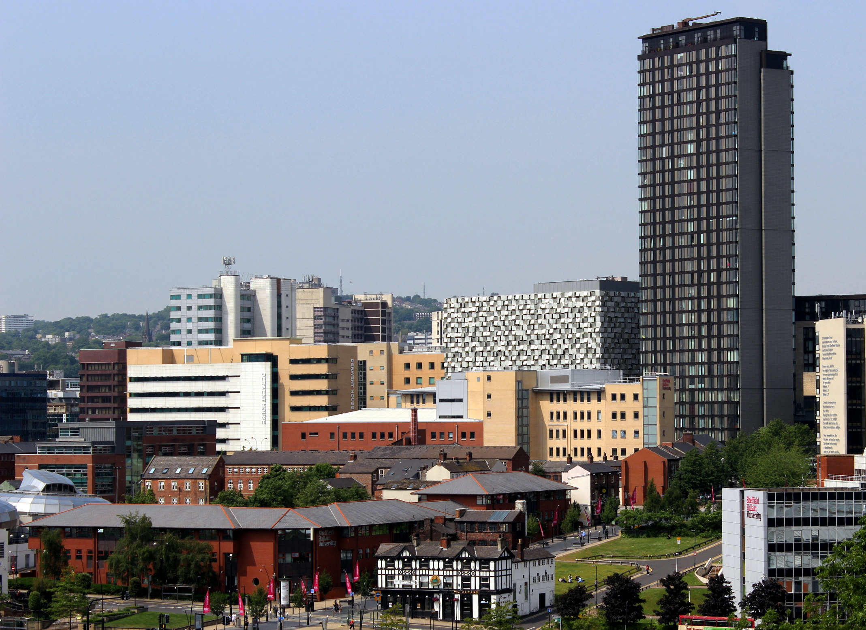
Media coverage – Sheffield Star
Sheffield health chiefs’ budget plan ‘ambitious’
Plans to create the country’s biggest joint budget for
health and social care services in Sheffield have been
singled out for praise.
The NHS Sheffield Clinical Commissioning Group and
the City Council want to create a pooled budget of
£278 million, meaning they will work together more closely to run services.
Next year a new national policy called the Better Care Fund comes into force, which orders CCGs and Councils to pool £41 million from their existing funding - meaning that, in Sheffield, £237 million more is being added to the pot than officially required.
The focus will be on setting up a single service to support people following a spell in hospital or social care, and providing more alternatives to hospital wards.
June 2014

Slide 9
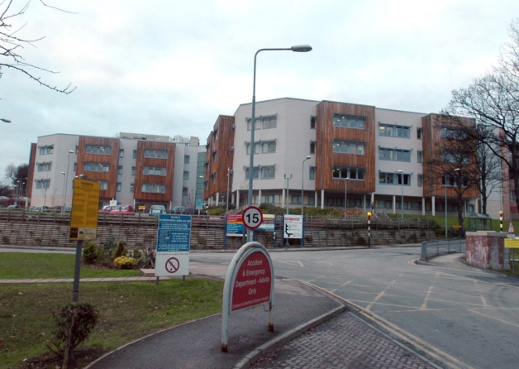
Media coverage – Sheffield Star
Sheffield A&E is fit for winter freeze
Extra nurses, more ambulances and longer GP opening
hours are all being planned to avert a crisis at A&E in
Sheffield this winter, The Star can reveal.
Health chiefs in the city have announced details of
proposals to stop the emergency ward at the Northern
General Hospital being inundated with patients in freezing weather.
The NHS Sheffield Clinical Commissioning Group has set aside hundreds of thousands of pounds to pay for extra workers, increase the number of care beds, provide longer GP opening hours and lay on more ambulances to transfer patients between hospitals.
Idris Griffiths, the commissioning group’s chief operating officer, told The Star a ‘very demanding winter’ is expected. But he added: “We’re confident we’re doing all we can to prepare for winter.”
November 2013

Slide 10

Media coverage – Health Service Journal
Sheffield shows foresight with new eyecare model
A new approach to eyecare in Sheffield, saves money,
develops new leaders, improves the patient experience
and provides lessons other areas can follow,
writes Dr Richard Oliver.
The NHS is facing an unprecedented squeeze with
healthcare budgets under increasing strain. At the same
time, the ageing population’s needs are becoming ever more expensive. The demand on the health service is such that it must deliver more care with fewer resources.
‘Our patients can now be seen at times and places that are more convenient for them. We estimate we are saving Sheffield CCG around £400,000 a year’.
In Sheffield, one way we have addressed this is with the introduction of a new approach to eyecare, which saves money, improves patients’ experiences and provides a model other areas can follow − as well as demonstrating how leadership can make the introduction of new services more effective.
October 2013

Slide 11
Our Challenges
Making sure we balanced our books and passed our assurance tests– Julia and Ian will update on the detail of our success
Making sure we engaged with you and our member practices
Making sure we responded to the national challenges of Integration (The Better Care Fund) and Co-commissioning
Making sure our contribution to the City Health and Wellbeing Board delivered real clinical focus

Slide 12
Clinical Commissioning for Sheffield
A successful first year
Integration of Health and Social Care – ahead of the country
Primary and Community service development – particularly going forward
Clinical Outcome based contracts with our providers
Involve Me – your voice is more important than ever – Ted and Mark will tell us more shortly
Quality of services is at the heart of all our decisions
Working with our hospitals and Council to improve services

Slide 13
Ian Atkinson
Accountable Officer
Julia Newton
Director of Finance

Slide 14
Making sure the CCG delivers its legal duties
The way we are organised as a CCG has been reviewed as effective by our auditors and NHS England
We had 4 Assurance meetings with NHS England throughout the year and had full assurance each time - “It is clear that the CCG has had a positive first year and should be proud of what it has achieved” NHS England Q4 Letter
As Julia will describe, we have balanced our books

Slide 15
CCG Financial Performance 2013/14
We balanced our books
  Delivered 1% (£6.9m) surplus required by NHS England
We managed our cash
  CCG remained within our cash limit of £669m
We stayed within our Running Costs Allowance
Actual spend of £9.7m (£17 per head) compared to maximum allowance of £14.1m (£25 per head)
Positive report from External Auditors
  We had an unqualified opinion on our accounts

Slide 16
How Did We Spend Each £
 | 2013/14 Pence
Primary and community services | 13**
Prescribing by GPs | 13
Acute Hospital Care
Elective care | 19
Urgent care | 20
Other e.g., maternity, critical care | 13
Ambulance services | 3
Mental health and learning disabilities | 12
Long term care | 7
 | 100
**The CCG unlike Sheffield PCT does not contract for the core services provided by GPs, dentists and pharmacists. NHS England contracts for these services along with specialised hospital services.

Slide 17
Our Plans for 2015/16
Dr Zak McMurray
Clinical Director

Slide 18
We are guided by our strategic aims
Our four prospectus aims remain at the heart of our ambition
To improve patient experience and access to care
To improve the quality and equality of healthcare in Sheffield
To work with Sheffield City Council to continue to reduce health inequalities in Sheffield
To ensure there is a sustainable, affordable healthcare system in Sheffield
We have committed to the priorities in the Joint Health and Wellbeing Strategy
Sheffield is a healthy and successful city
Health and Wellbeing is improving
Health inequalities are reducing
People get the help and support they need
Services are affordable, innovative and deliver value for money
And we see a shift of care closer to home as a key part of achieving these aims, reducing the need for travel to hospital by supporting people better in local communities.

Slide 19
What we need to respond to

Slide 20
Our ambitions for the next five years are unchanged
All those who are identified to have emerging risk of admission through risk stratification are offered a care plan, agreed between them and their clinicians (possibly 15,000 people)
By establishing integrated primary care and community based health and social care services, care planning, and holistic long term conditions management to support people living independently at home, reduce emergency admissions by up to 20%, Emergency Department attendances by up to 40%
Minimise repeated trips to the GP and hospital for specialist diagnosis and monitoring of health problems, replacing them with community and home based services that make best use of technology, and keep people at the centre of their care
Reduce the gap in life expectancy for people with mental health problems and learning disabilities
Put in place support and services that will help all children have the best possible start in life
2015/16 is the second year of the plans for 2014-16 already published
Notes:
These numbers are to be tested – but I think useful to give public a sense of scale of change

Slide 21
Our Priorities for Next Year
Focussing on improving care for people with the worst health, including older people, people with several long term conditions and those with respiratory conditions,
With the City Council, through integrated commissioning, we plan to:
  Extend care planning
  Test the “Keeping People Well in Their Communities” model proposed in our integrated commissioning plans
  Specify and procure improved intermediate care services
  Establish an integrated approach to long term health and social care

Slide 22
Our Priorities for Next Year
CCG specific priorities include:
  Improving community nursing services
  Mobilisation of the outcomes based contract for musculoskeletal services
  Contributing to delivery of Sheffield’s Health Inequalities Plan
  Transforming outpatient services
  Redesigning urgent care services
To help achieve these aims, we will be working with NHS England to:
  Have more influence over commissioning of primary care services
  Be actively involved in and supporting NHSE commissioning of specialised services
And will be supporting primary care providers to establish a collective approach to care provision, and collective working with other providers

