Slide 1
Sheffield Patient Participation Group Network
12 October 2017
Mandy Forrest Mark Gamsu
Lay Members

Slide 2
Commissioning for Value
Abby Tebbs
Deputy Director of Strategic Commissioning and Planning

Slide 3
What is Commissioning for Value?
‘It is about identifying priority areas which offer the best opportunities to improve healthcare for populations – improving the value that patients receive from their healthcare and improving the value that populations receive from investment in their local health system’

Slide 4
Why do we need commissioning policies?
Pressure on NHS resources increases year on year
Focus on opportunities to improve value patients receive from their healthcare and improving value populations receive from investment in the local health system
CCGs regularly review treatments to ensure NHS money is spent on things that will bring greatest benefit.
Policies help identify interventions with limited or no benefit to most patients (PLCV) e.g. cosmetic surgery
Use national recommendations (e.g. NICE guidance) and latest clinical evidence
Notes:
Operations or treatments that medical experts agree offer only limited or temporary benefit and which are not considered necessary to maintain good health
CCGs regularly review treatments to ensure NHS money is spent on the things that will bring greatest overall health benefit to local people.
This is done using national recommendations and best practice, such as the National Institute for Health and Care Excellence (NICE) guidance and by reviewing the latest clinical evidence

Slide 5
What happens at present?
Surgery should be a last resort - other appropriate options considered first.
Clinical policies in place for certain treatments e.g. carpal tunnel, cataracts, hip and knee replacements, plastic surgery (cosmetic procedures), hernia repairs, tonsillectomy and grommets
GPs or consultant have to confirm if patient meets clinical threshold for the procedure
In exceptional circumstances, an Individual Funding Request (IFR) application can be made - considered by an independent panel
Notes:
What happens now
Surgery should be a last resort for a number of conditions and should not take place before considering other appropriate non-surgical options. GPs will look for alternatives to surgery for certain procedures where clinical thresholds apply.
Currently, we have a list of treatments that will only be considered if they meet specific criteria - or clinical thresholds.
The full list is available on our website and includes surgery for carpal tunnel, cataracts and gall bladder, hip and knee replacements, plastic surgery, hernia repairs and tonsil removal.
GPs have to complete a referral checklist, which is then countersigned by the hospital consultant to confirm the patient meets the clinical threshold.
If GPs or consultants think that there are exceptional clinical circumstances that mean a patient may benefit from a treatment which is not routinely provided, they can request this treatment by making an Individual Funding Request (IFR). These requests are considered by an independent panel, who decide whether it should be funded.

Slide 6
Why develop a regional approach
Policies and clinical thresholds vary between CCGs - confusing for public and providers
Consistent approach - same interventions, same criteria and process
Local clinicians have reviewed all current policies and identified new treatments for policy development
Evidence review and clinical discussion to agree a single set of criteria for each,
Single process developed
CCGs to review and agree locally to implement Dec 17
Notes:
Regional approach
All CCGs take this approach but have individual policies and clinical thresholds so these may vary.
We have been working with other CCGs in South Yorkshire to look at how we can have a more consistent approach across the region and ensure our policies are based on the most up to date evidence and best practice.
This may mean that we make some changes to which treatments are classed as being of limited clinical value and the clinical thresholds for treatments.
How we will do this
Xx
xxx

Slide 7
Benefits
Improved equality across the region
Clear policy and process for all people living in South Yorkshire and Bassetlaw
Treatment based on the best clinical evidence and recommendations
Ensures best use of public money and NHS resources

Slide 8
What might change in Sheffield?
Slightly revised criteria for existing PLCV e.g. tonsillectomy, varicose veins, grommets
New policies covering e.g.
asymptomatic gallstones
second eye cataract surgery
orthopaedic procedures e.g. hip and knee
Shared policy and process
Procedures that no longer require IFR approval – refer direct to secondary care if meet criteria

Slide 9
Discussion
What do you think to the approach we have described and the expected benefits?
Do you think we have considered everything? Is there anything else we should be thinking about?
What communication would be helpful for patients and the public to receive?

Slide 10
Making Urgent Care work better in Sheffield
Kate Gleave

Slide 11
You’ve told us we need to
Make it simpler for people to get the care they need as quickly as possible
Improve access to GP appointments
Make more care available closer to people’s homes
Make best use of services
Notes:
1000s of people told us current system is confusing and not always able to get the care they need quickly. – I don’t always know where to access/get access when I think I need it
We are not reducing spend on services, just spending the money differently. Same for staff too
People say current system is confusing – not always sure where to go, can end being redirected which delays treatment
Access to urgent care at GPs varies across the city – in some areas is difficult to get an appointment quickly
Some people going to A&E as can’t get GP appointment quickly
Demand growing – huge pressure on GPs
Duplication – not best use of NHS staff and resources
Workforce challenges - need to look at different ways of working
National guidance and best practice – requirement to introduce UTCs, recommendations that GP practices work together to meet local needs (e.g. as doing with neighbourhood approach)
Key focus of review is helping people get the right care as quickly as possible
We need to improve access to GP appointments
Aiming to make more care available closer to people’s homes – GP appointments, urgent eye care. Improving access to GP appointments will mean fewer people need to travel out of their local area for urgent care. Also helping people make better use of other options nearby – pharmacies, other health professionals working in GP practices such as specialist nurses, mental health workers etc.
Ensure sustainable services - not about saving money but making sure we spend it in way that best meets people’s needs and will make services sustainable. Similarly not cutting services – we’ll be providing them in different way
What is an urgent treatment centre?
New service required by latest national guidance
Led by GPs that oversee a range of primary care health professionals
Located alongside both of our A&E departments for quick transfer between services where needed
Treats minor illness and injuries including minor head injuries
Provides direct access to simple diagnostics such as x-rays, blood tests, ECGs, emergency contraception and mental health advice/services
Open 365 days a year
Offers both pre-booked same day and ‘walk-in’ appointments via NHS 111
Why urgent treatment centres instead of walk-in centres and minor injuries units?
Less confusing because they are co-located with hospital services such as A&E. This means if your problem turns out to be serious, A&E is located close by and vice versa.
Urgent treatment centres are GP-led services which means staff would be able to access your patient care records. The walk-in centre and minor injuries unit cannot.
Urgent treatment centres treat both minor illnesses and injuries in one place.
Access to urgent treatment centres is via an appointment booked by your practice or 111.
National guidance says we need to provide urgent treatment centres.

Slide 12
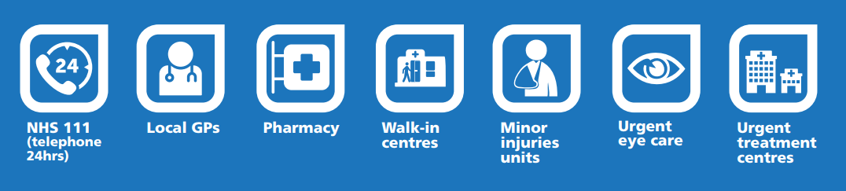
What is urgent care?
Treatment for minor illness and minor injuries that are urgent but not life threatening
Notes:
In this city we have GP practices, Pharmacists, Opticians as well as
Walk In Centre at Broad Lane
Minor Injuries Unit at RHH
Emergency Eye Clinic at RHH
Out of Hours GP service at NGH

Slide 13
What are we proposing?
Improve the way people access services
Change the way people get urgent GP appointments
Change where people would go for minor illness and injuries
Change where people go for urgent eye care
✓
Notes:
4 main changes:
Change the way people get urgent GP appointments
Groups of GP practices will work together to offer urgent appointments within 24 hours.
People will be assessed to decide if they need to see their own GP or can be seen by at a different GP practice in their local area.
Change where people would go for minor illness and injuries
Currently, there is a walk-in centre in the city centre which treats adults and children for minor illnesses and a minor injuries unit at the Royal Hallamshire Hospital that deals with adult minor injuries.
Children with minor injuries are seen at the emergency department at Sheffield Children’s Hospital.
Under our preferred option, the walk-in centre and minor injuries unit would be replaced with an urgent treatment centre for adults at the Northern General Hospital for both minor illness and injuries and an urgent treatment centre at Sheffield Children’s Hospital which would treat minor illness. Children with minor injuries would continue to be treated at Sheffield Hospital’s emergency department.
Both urgent treatment centres would offer booked appointments and walk-in appointments.
Change where people go for urgent eye care
Currently adults needing either urgent or emergency eye care are seen at the Emergency Eye Clinic at the Royal Hallamshire Hospital.
In the future, urgent appointments would be offered at locations across the city with extended opening times making it easier for people to get care closer to where they live.
Emergency eye care (sight-threatening conditions) would continue to be provided at the Hallamshire.
Improve the way people access services
People would be supported by an improved system where you can contact your practice or 111 and be assessed over the phone.
You will then be booked an appointment or signposted to the right place for the care you need.

Slide 14
We are not
x
Cutting or reducing emergency services (A&E)
Changing planned GP appointments
Closing the Emergency Eye Clinic
Making any changes this winter

Slide 15
3 options for urgent treatment centres
Northern General Hospital
Sheffield Childrens’ Hospital
Notes:
Are proposing to have 2 urgent treatment centres in the city, our preference is one for adults and one for children. Further info in consultation docs
There are three options for how the urgent treatment centres could work for adults and children
Option 1 is our preferred option as is the simplest – people just need to go to either NGH or SCH depending on whether an adult or a child
Option 1
(Our preferred option)
Both minor illnesses and minor injuries at UTC at Northern General Hospital
Minor illnesses - UTC at Sheffield Children’s Hospital
Minor injuries - Emergency dept at Sheffield Children’s Hospital
Option 2
Both minor illnesses and minor injuries at UTC at Northern General Hospital
Minor illnesses – UTC at Northern General Hospital
Minor injuries – Emergency dept at Sheffield Children’s Hospital
Option 3
Minor illnesses – UTC at Northern General Hospital
Minor injuries – Emergency dept at Northern General Hospital,
Minor illnesses – UTC at Sheffield Children’s Hospital
Minor injuries - Emergency dept at Sheffield Children’s Hospital

Slide 16
How might it look in the future?
Notes:
current story vs signposting, appointment same day, right clinician
Increased triage and booked urgent appointments - less need to ‘turn up and wait’
Patients will be seen by most appropriate clinician
Patients who need continuity of care will be seen by their GP practice
Urgent appointments within 24 hours of initial request across the entire city
Call backs for patients if needed

Slide 17
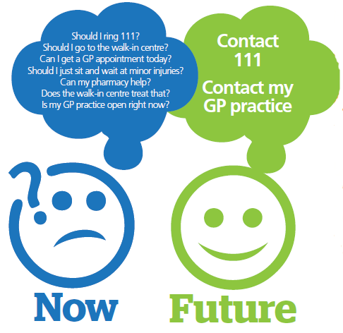
Benefits for people in Sheffield
24 hr
guarantee
Right care
closer
to home
Notes:
Simplified services, making it as easy as possible to get the care you need first time
Guaranteed urgent GP appointments within 24 hours
More people able to get urgent care close to home
+
Less pressure on A&E – shorter waits
Reduced duplication of services and best use of local taxpayers’ money

Slide 18
Consultation process
Please let your practice population know
We want to hear what people think by the 18 December 2017
Notes:
Full document and other info on website
How can your PPG support this consultation
Wide range of activities including public meetings and drop in sessions, plus meetings for staff and clinicians.
Online questionnaire – please give your views
Independent analysis of feedback – will be used to inform final decision in new year.

Slide 19
Next steps
A report of this meeting will be sent to you
Please continue discussions within your PPGs and Practices

Slide 20
Thank you for coming
We would really appreciate your feedback, please complete an evaluation form

