Slide 1
Sheffield prescribing update
Public meeting
16 March 2016
Zak McMurray
Peter Magirr

Slide 2
Who are we?
We plan and buy health services for the people of Sheffield
We are clinically-led
11 clinicians on our Governing Body
5 Clinical Directors
Membership organisation.
87 GP practices

Slide 3
Sheffield CCG Spending ‘Care’fully 2016/17
We have £737m to spend on the City’s health services in 2016/17
Even though that’s more than we got last year, it’s still around £30m less than we need if we continue to do the same.
Notes:
Campaign name? ‘Spending Care fully’ or ‘Healthy Finances’ or …….
Need ‘public friendly’ list of what exactly we spend our money on
Any thoughts for throughout the presentation about images/ graphs that would help illustrate

Slide 4
Why £30m?
Inflation
National insurance increases
National minimum wage
Withdrawal of central funding
Changes in population
NHS Constitution pledges

Slide 5
Why will we spend more?
Similar to across the country, Sheffield:
Has an ageing population
Is seeing a rise in long-term conditions
Has less money, due to the expected continued reduction in funding for councils, and the increasing cost of providing care
Has a year on year increase in hospital activity, and demand for long term care
Has waiting time pressures

Slide 6
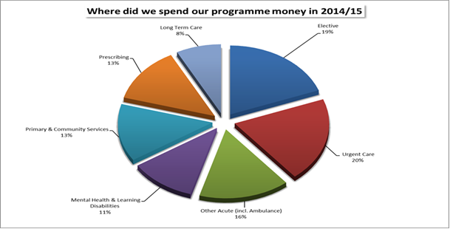
Where do we spend the money?
For every person in Sheffield an average of £1600 is spent on healthcare

Slide 7
What are we doing about it?
Increased efficiencies
Cost effectiveness
System redesign

Slide 8
Prescribing Issues
Budget £94.5 million in 16/17
Cost up more than 7% over last year
due to:
More prescribing
New, more expensive products
Overspend on prescribing = cutting elsewhere

Slide 9
Prescribing Changes
Criteria – cost effective / least harmful
Prescription order line
Paracetamol for short term use
Vitamin D supplements
Melatonin
Gluten free products

Slide 10
Why gluten-free prescribing?
Products more readily available over the counter than when prescribing guidelines were produced.
Increasing knowledge and availability of naturally gluten free foods.
Additional costs involved in prescribing and dispensing.

Slide 11
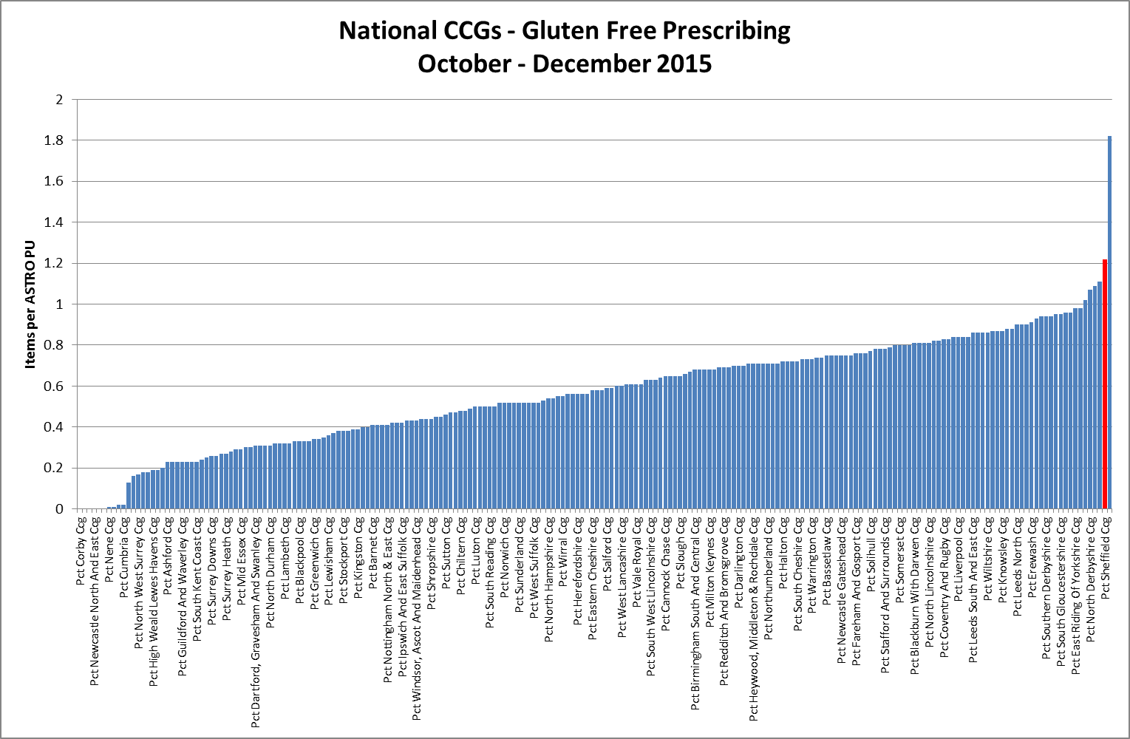
What do we spend on gluten free prescribing?

Slide 12
Why does it cost so much to prescribe?
Cost of the product itself.
Professional fees paid to the pharmacy for dispensing it.
Reimbursement of any costs that the pharmacy has incurred in sourcing the product.
Costs to the practice in prescribing it.
Costs of the NHS Business Services Authority in billing the CCG and making payment to the pharmacy.
These costs would be similar for voucher schemes

Slide 13
What have we changed?
Recommendation to limit the prescribing of gluten free products to 8 units per month per adult patient.
Encouraging GPs to have conversations with their patients about what best suits their needs and which products would be best supported through a prescription.
No changes to gluten free prescribing for children.
Notes:
(non-pregnant and non-breastfeeding)

Slide 14
What have people told us?
People who have made lifestyle choices, like smoking and drugs, are not having reduced support.
Longer term cost implications.
Negotiate cheaper price with suppliers.
Cut down on waste medicines.
Are there further plans to stop all gluten free prescribing?
Notes:
Respond to these:
Drugs – keeping society safe
Smoking – Very cost effective. Limited spend, big savings

Slide 15
What we will do
Continue to support Coeliac patients with gluten free prescribing.
Offer dietary advice sessions if there is enough interest.

Slide 16
What we can’t do
Change national policy – but we can raise issues.
Influence manufacturers and suppliers - but we are happy to support.
Offering voucher scheme or subsidies have been explored, but they simply shift costs across the system – no saving.

Slide 17
We want to hear from you

