Slide 1
Individual Health Care Plans (IHCP) for children and young people

Slide 2
Aims and Objectives
To understand what an individual health care plan is
To understand the need and importance of the care plan when a child starts school
To understand what contributes towards a care plan and other considerations
Roles and Responsibilities of care planning
To develop confidence in completing care plans using a multi-disciplinary approach

Slide 3
What are Individual Health Care Plans
The main purpose of an individual health care plan for a child/young person with a medical need is to identify and clarify the level of support to attend education and ongoing management of a medical need

Slide 4
Why are they important?
Provides key information to help create a safe environment for the child/young person to attend education
Creates better relationships between Parents/Carers, Education and Health
Enables the school and child/young person to access appropriate support/provisions eg Training, groups etc to further their education and training
Smooth transition when a child/young person moves through education

Slide 5
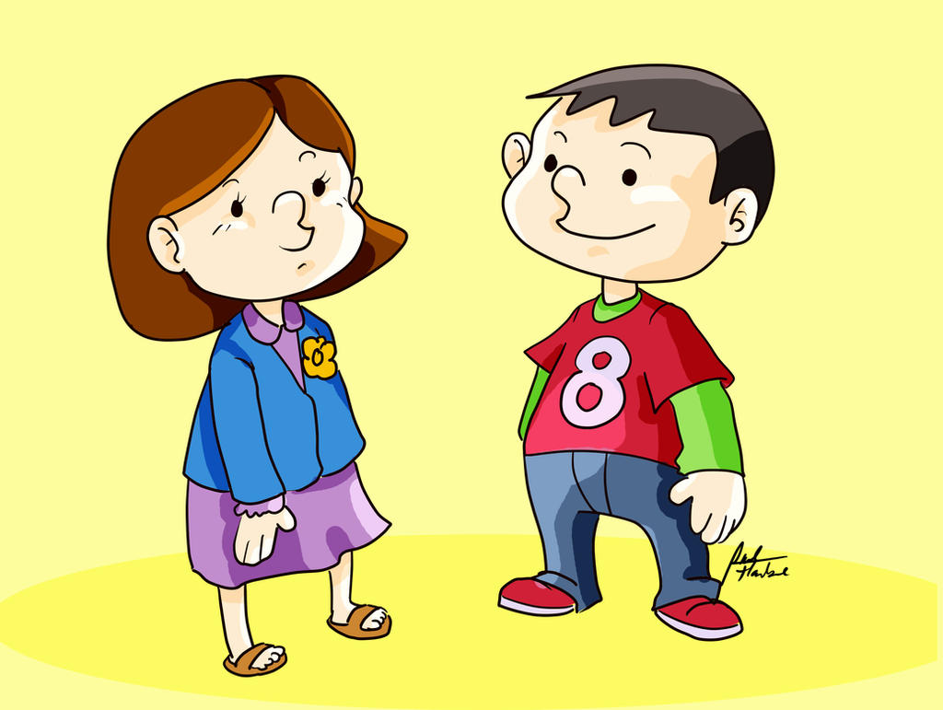

Slide 6
What is needed in a plan and what to consider
Personal details
Description of medical need
Describe the level of support needed from Education
Describe what constitutes an emergency and what the action to take if this occurs
Emergency situations and who is responsible
Daily Care Requirements
Specific support for child/young person’s education, social and emotional needs
Other Information such as school trips
Who is responsible and contributing towards this care plan

Slide 7
Training Needs
Does the Individual Health Care Plan require training or advice?
What does the training/advice entail?
Where do you get the training/advice from?
Confidence and Competence

Slide 8
Overcoming Challenges
Early planning and intervention
Open and honest conversations
Involvement of everyone including parents/carers, the child/young person, Education Provision’s and Health professionals

Slide 9
Key Messages
Developing an individual health care plan should not be an onerous task and each will contain different levels of detail according to the individual needs of the child /young person
Any health intervention carried out on a child/young person will need a care plan
Care plans need to be updated annually or sooner if the child/young person’s medical condition changes or at parent/carer requests

Slide 10
Thank you ☺

