Slide 1
Sheffield
Patient Participation Group Network
19 June 2017
Mandy Forrest – Lay Member

Slide 2
Neighbourhoods Update
Nicki Doherty – NHS Sheffield CCG
PPG Network Event
Monday 19 June 2017

Slide 3
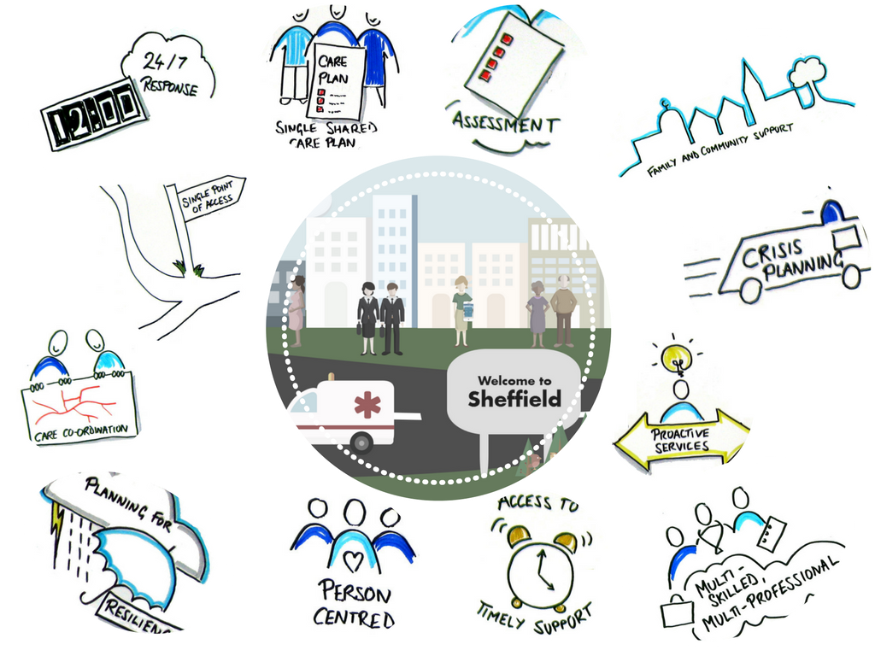

Slide 4
What is a Neighbourhood?
16 Neighbourhoods across the city.
Working together with their ‘neighbours’ from hospital, community, mental health, social care, housing services and local voluntary groups.
Population of 30-50,000 people.

Slide 5
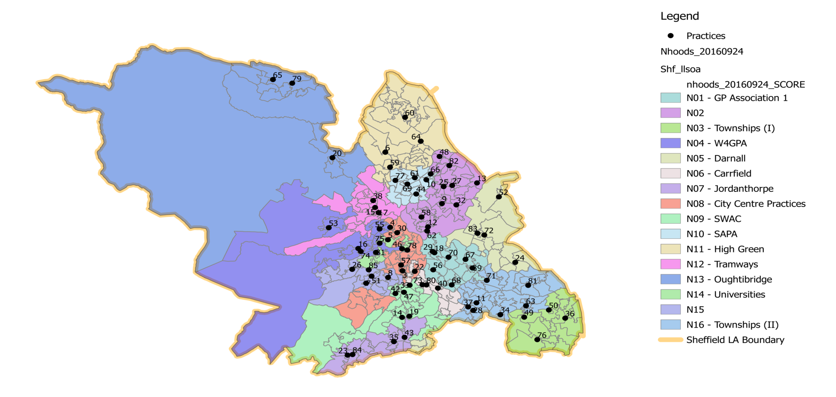
16 Neighbourhoods Across Sheffield City
4 in Central
4 in Hallam & South
3 in North
5 in West
High Green
Upper Don Valley
SAPA
- North2
North2
- West4
Darnall
- Peak Edge
GPA1
Dovercourt Surgery | 70
Duke Medical Centre | 29
East Bank Medical Centre | 68
Manor Park Medical Centre | 67
Norfolk Park Medical Practice | 56
Park Health Centre | 18
White House Surgery | 39
North 2
Burngreave Surgery | 12
Dunninc Road Surgery | 48
Firth Park Surgery | 25
Page Hall Medical Centre | 9
Pitsmoor Surgery | 58
Sheffield Medical Centre | 62
Shiregreen Medical Centre | 82
The Flowers Health Centre | 27
Upwell Street Surgery | 32
Wincobank Medical Centre | 13
Townships I
Crystal Peaks Medical Centre | 50
Mosborough Health Centre | 76
Owlthorpe Medical Centre | 49
Sothall and Beighton Health Centres | 36
Hackenthorpe Medical Centre | 63
West 6
Broomhill Surgery | 31
Manchester Road Surgery | 16
Selborne Road Medical Centre | 74
Stannington Medical Centre (Shurmer) | 53
The Crookes Practice | 75
Walkley House Medical Centre | 55
Darnall
Clover Group Practice | 83
Darnall Health Centre (Mehrotra) | 72
Handsworth Medical Practice | 24
The Medical Centre | 52
- SSHG
West 6
GPA1
Hillsborough
Townships II
- Hillsborough
Student
- Upper Don Valley
Porter Valley
Townships I
- Porter Valley
City Centre
SSHG
Carrfield
Peak Edge
Carrfield
Carrfield Medical Centre | 73
Gleadless Medical Centre | 40
Heeley Green Surgery | 80
Sharrow Lane Medical Centre | 3
The Mathews Practice | 22
Peak Edge
Abbey Lane Surgery | 14
Avenue Medical Practice | 35
Baslow Road And Shoreham Street Surgeries | 23
The Meadowgreen Group Practice | 43
Totley Rise Medical Centre | 84
City Centre Practices
Crookes Valley Medical Centre | 5
Devonshire Green Medical Centre | 78
Harold Street Medical Centre | 4
Porter Brook Medical Centre | 57
Upperthorpe Medical Centre | 30
Clover City Practice | 54
SSHG
Carterknowle And Dore Medical Practice | 42
Sloan Medical Centre | 33
Veritas Health Centre | 47
Woodseats Medical Centre | 19
SAPA
Barnsley Road Surgery | 66
Buchanan Road Surgery | 61
Elm Lane Surgery | 10
Norwood Medical Centre | 44
Southey Green Medical Centre | 69
The Health Care Surgery | 77
High Green
Chapelgreen Practice | 60
Ecclesfield Group Practice | 21
Foxhill Medical Centre | 59
Grenoside Surgery | 6
Mill Road Surgery | 64
Hillsborough
Dykes Hall Medical Centre | 15
Far Lane Medical Centre | 38
Tramways Medical Centre (Milner) | 17
Tramways Medical Centre (O'Connell) | 41
Upper Don Valley
Deepcar Medical Centre | 79
Oughtibridge Surgery | 20
Valley Medical Centre | 65
Student
University Health Service Health Centre | 46
Porter Valley
Falkland House | 7
Greystones Medical Centre | 51
Nethergreen Surgery | 26
Rustlings Road Medical Centre | 85
The Hollies Medical Centre | 8
Townships II
Birley Health Centre | 34
Charnock Health Primary Care Centre | 28
Jaunty Springs Health Centre | 11
Richmond Medical Centre | 71
Stonecroft Medical Centre | 37
Woodhouse Health Centre | 81
Version 8
04 -05-17

Slide 6
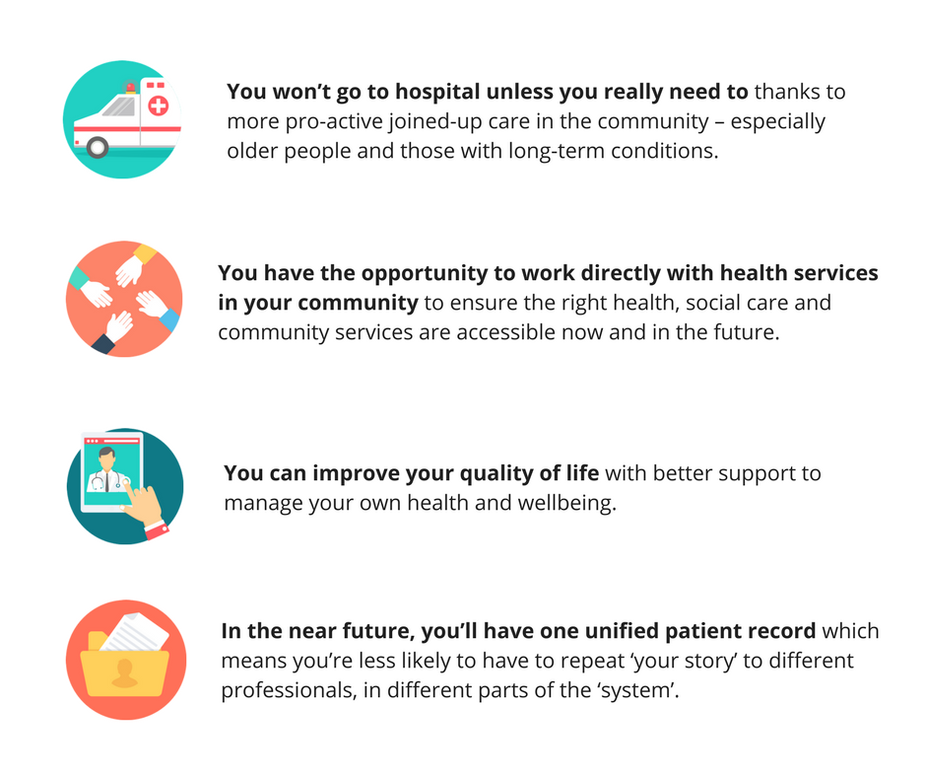
How do Neighbourhoods affect you?

Slide 7
Prioritising local needs first
Take a look at the ‘Welcome to our Neighbourhood’ factsheets
Local vs citywide

Slide 8
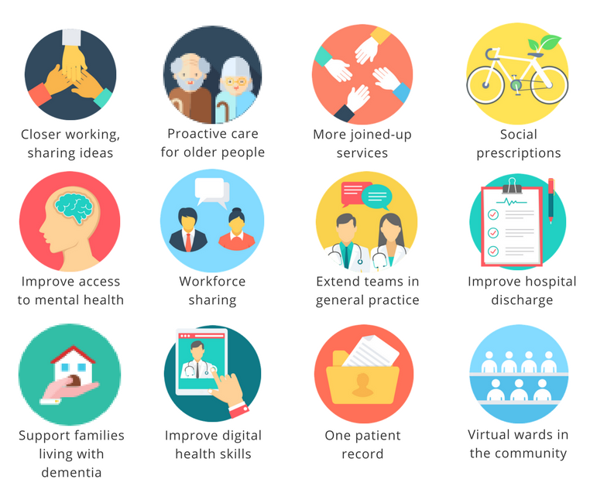
What’s happening in Neighbourhoods right now?

Slide 9
What’s happening in Neighbourhoods right now?
Closer working – practices attend regular Neighbourhood meetings together now to share ideas, knowledge and planning.
Proactive care for older people – better case management planning for older people e.g. Crystal Peaks.
More joined up services –Upper Don Valley Neighbourhood are working with their local Community Forum.
Social prescriptions – citywide approach utilising community support workers, People Keeping Well work.

Slide 10
What’s happening in Neighbourhoods right now?
Improve access to mental health – Sheffield has recently been awarded over £2m to join up Improving Access to Psychological Therapy (IAPT) services with 10 condition pathways such as musculoskeletal, pain, Long Term Conditions etc. They’re working with Neighbourhoods now to develop these both at local and citywide level. These will help Neighbourhoods with specific Mental Health needs and improve identification of anxiety and depression.
Workforce sharing – One Neighbourhood is using WhatsApp as a way to manage rotas and fill in gaps if a staff member calls in sick.
Extending teams – Peak Edge Neighbourhood pilot using paramedics to manage housebound patients to avoid hospital admission.
Hospital discharge – lots to come on this that will help avoid people being delayed when being discharged into the community.

Slide 11
What’s happening in Neighbourhoods right now?
Support families living with dementia – setting up cafes, drop-ins for family members etc. with local voluntary and community organisations.
Digital health skills – Sheffield has been chosen as a pilot to trial improving digital literacy with NHS England & Good Health Foundation.
One patient record – this is on its way.
Virtual wards – successful pilot in GPA1 Neighbourhood – now being tested across 4 Neighbourhoods in Central locality (20 practices) with hope we can spread citywide later in year.

Slide 12

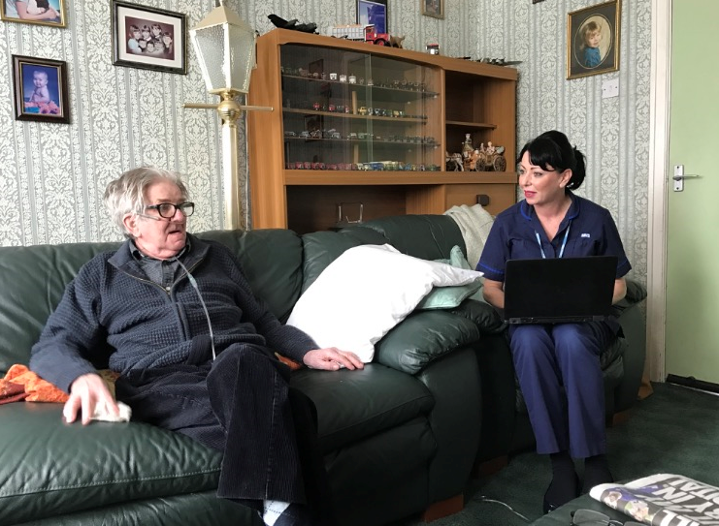
Colin’s Hospital Timeline
A+E Attendances
Hospital Admissions
Out Patient
Prior to OK to Stay Plan
From January to April, 7 admissions resulting in 35 days in hospital
After OK to Stay Plan
1 A&E attendance and 1 recent 3 day admission
Outpatient Appointments attended to ensure appropriate primary and secondary care interventions and collaboration

Slide 13
Over to you
Take a look at the profiles sheets on your table:
Q1: Are we missing anything obvious from your area?
Q2: How can PPGs help to support Neighbourhoods?
Q3: How would you like Neighbourhoods keep you informed and involved?

Slide 14
Resources for you
Web pages / Intranet pages established
Sheffield.neighbourhoods@nhs.net – central mailbox
Neighbourhood News - over 260 subscribers.
  Subscribe here http://bit.ly/2siXoTm​
Toolkits in development
Social media and sharing news in other external bulletins around the city

Slide 15
Next steps for everyone
‘Neighbourhoods, Neighbourhoods, Neighbourhoods’
  Keep talking about it
  Get on PPG agendas
  Team up with your PPG ‘neighbours’
Changing Neighbourhood priorities
Look out for new resources
Joint efforts – you are invaluable as local experts so don’t be afraid to talk to us. Email your NH lead or sheffield.neighbourhoods@nhs.net
Do you have any quick links already to VCS?
How can we reach ‘harder to reach’ groups?

Slide 16
Thank You
Questions?

Slide 17
Clinical Outcomes – MSK Sheffield
Jill Lomas
Programme Manager
MSK Sheffield

Slide 18
Outline
Why collect outcomes?
The vision of how
The process of getting there
“My Platform”
What next?

Slide 19
Background – Patient Reported Measures
Terminology
PROM
  Patient Reported Outcome Measure
  Symptoms, Functional Status, Health Related Quality of Life
    Generic or Disease specific
PREM
  Patient Reported Experience Measure
  Questions relating to healthcare experience

Slide 20
Background – Process Measures
Data collected by healthcare providers
  How long patients wait
  Complication rates
  Length of time in hospital
  Proportion of patients starting treatment for new onset inflammatory arthritis within the recommended timeframe.

Slide 21
Why Collect Clinical Outcomes Information?
CCG asked for a different kind of service model
  measured by how much difference we make to the patients we treat (clinical outcomes), rather than just how many we see
Patients perspective is highly relevant to efforts to improve quality and effectiveness of healthcare
In many cases we genuinely don’t have good evidence for the difference we make to the health of our patients
We want to improve the care we provide and to do so, need to understand what works well, what doesn’t, and to be able to measure the impact of change

Slide 22
The Vision of How
Embed PROM collection into routine clinical care (45,000 new patient referrals each year)
Quickly realised that we couldn’t collect, analyse and report this information on paper without employing a small army of people
IT solution
Negotiated for this to properly funded
Designed initial specification for product
Started a process of tendering for a supplier

Slide 23
Product Specification
Highly accessible, user friendly IT based collection of data
Asks the right patient, the right questions at the right time(s) in a way that encourages them to answer, and feeds information back to patients and clinicians about their progress
The system assists clinical care – guiding patients to useful information that supplements and enhances their treatment
Allows us to combine individual and group level patient reported measures, with clinical information about specific treatments (such as waiting time, complications etc)
The CCG would like to be able to expand the use of the product beyond MSK over time

Slide 24
The Tender – Autumn 2015-Christmas 2016
25 suppliers down to 1
We read many thousands of words, and listened to a lot of presentations
Demonstration event with patient involvement
Negotiated hard on features and price
Survived several challenges by unsuccessful bidders
Winning product was our unanimous first choice throughout
The process informed our requirements of the product, and gave us confidence that we had the best tool (and company) available to meet our needs

Slide 25


My Pathway – ADI
Web based platform and App
Works on mobile phones, tablets & computers
Interacts with existing hospital systems to know what treatment the patient is receiving and when – ‘pathway’
Can ask patients PROMs and PREMs at appropriate points in their treatment
Report information to
  Patients
  Clinicians
  The System as a whole

Slide 26
My Pathway – ADI
Aiming to significantly enhance patients experience of interacting with us
  From booking initial appointment to discharge once treatment completed (and perhaps beyond)
Improving communication between clinician and patient via a ‘timeline of treatment’
Providing tailored resources to enhance treatment & support self management – information ‘leaflets’, videos etc
Potentially able to measure activity levels
Streamline some of our existing booking processes

Slide 27
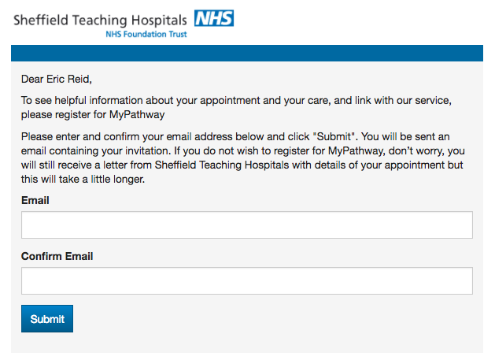
What the patient sees -email or text
Your GP referred you on “15th October 2016” to start the next stage of your care. To book your first appointment, see information to help you and link with our service please register for MyPathway. You can use MyPathway on a computer, a tablet or a smartphone. We hope you find this to be a really valuable addition to your care.
Please “Click here to get started”
If you do not wish to register for MyPathway, don’t worry, you will still receive a letter from Sheffield Teaching Hospitals asking you to book your appointment but this will take up to 10 days.
Thank you,
Sheffield Teaching Hospitals

Slide 28
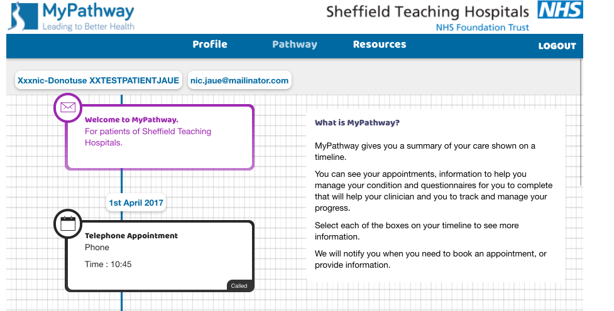
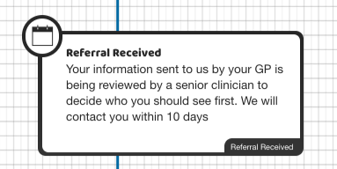
Patient receives welcome message
Patients receive Welcome message including a video of how to use it

Slide 29
Patient receives welcome message
Tap/click on each ‘lozenge’ gives the patient more information

Slide 30
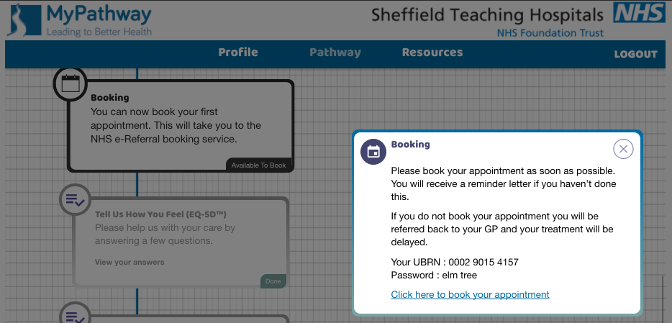
Booking appointments
Patients can book their initial appointment via MyPathway to eRS

Slide 31
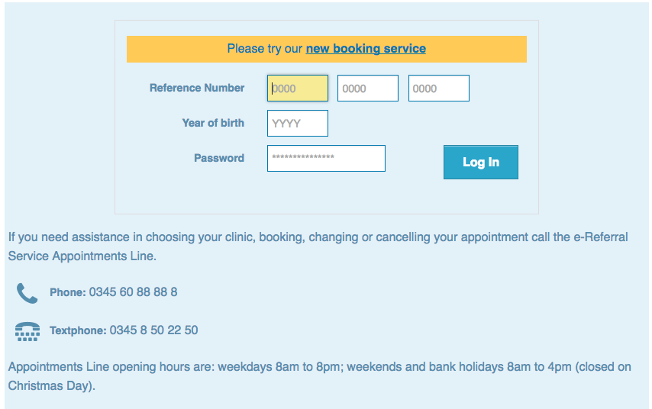
Booking appointments
Patients can book their initial appointment via MyPathway to eRS

Slide 32
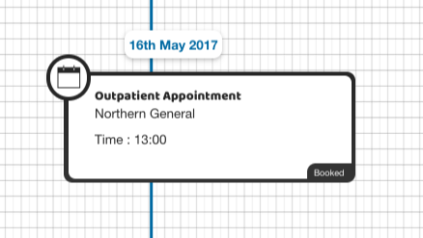
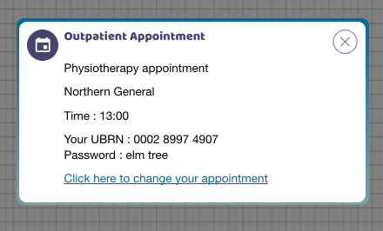
Booked appointments
Booked appointments show on MyPathway

Slide 33
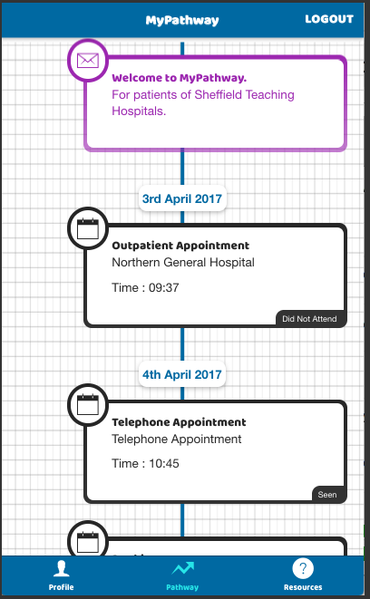
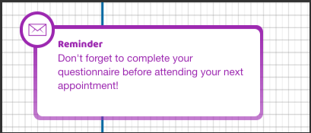
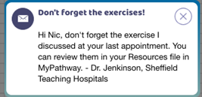
Appointment status, changes, reminders….

Slide 34
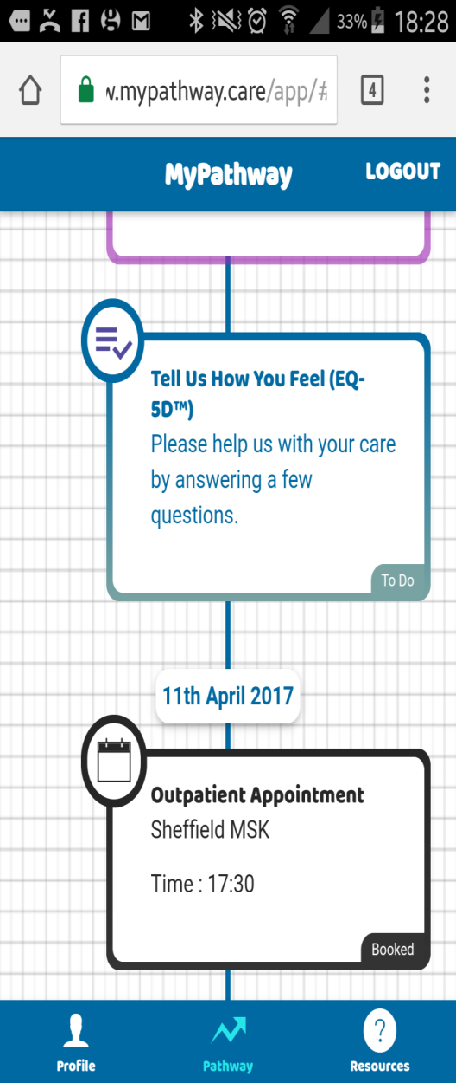
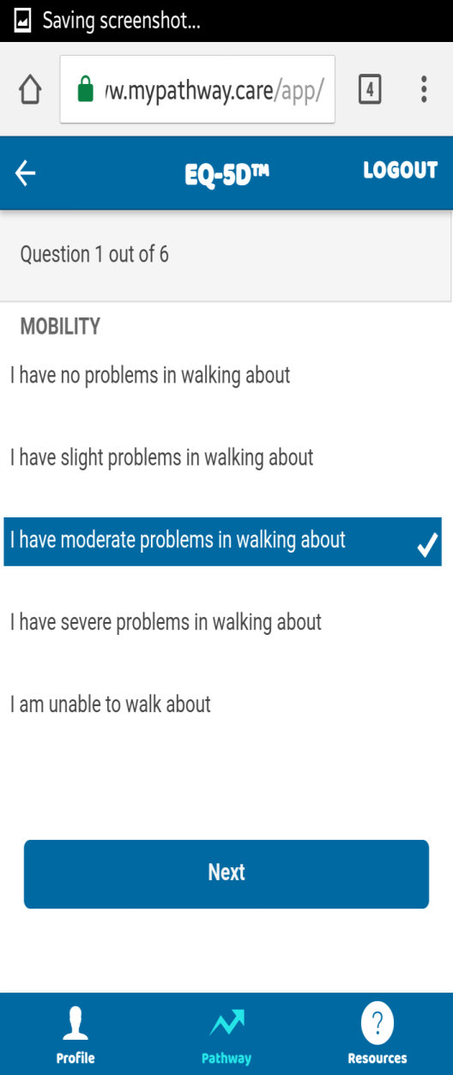
PROMs
Questionnaires can be linked to:
  Initial Referral
  Before or after any appointment
  Discharge
  Regular intervals
Results available to clinicians and aggregate reports available for analysis.

Slide 35
Resources for Pathways “Rules Engine”
Any appointment can be associated with:
  Resources, such as leaflets, weblinks, videos
  Messages, personalised or generic
  PROMs, such as EQ-5D
  PREMs, such as Friends and Family
Each element can be timed to occur before or after the associated appointment by a number of days
Resources can be made available automatically to patients according to their diagnosis, or clinicians can push resources to patients on an individual basis
Each element can be sent individually to patients if needed.

Slide 36
Initial Evaluation & Next Steps
Understand what proportion of our patients will use the system and gain feedback from those that do, to improve it
What do we need to do to engage those that don’t
  ?tablets in clinics
  Additional language support (in contract)
  Process for patients requiring reasonable adjustments
Evaluation of the data and establish baseline
  Forming a collaboration with academic teams in ScHARR
  Integrate patient reported and process measures
Integration with independent sector systems

Slide 37
Future Challenges
Engaging 300+ clinicians to integrate outcomes collection into “the way we work” – using PROMs as we do other investigations to help guide and monitor treatment
Engaging ‘digitally reluctant patients’
Developing our understanding and confidence in the analysis of PROM data
Presenting data to patients to help them choose treatment, timing and provider
Working differently as a consequence of PROMs = reduction in need for some face to face follow up

Slide 38

ELECTIVE CARE
Debbie Stovin, Commissioning Manager, NHS Sheffield CCG
Chris Kearton, Director, Primary Care Sheffield

Slide 39
What is Elective Care?
What are the CCGs plans for change?
How does CASES fit?

Slide 40

Sara’s Journey
All videos can be found at www.sheffieldccg.nhs.uk/cases.htm

Slide 41
Why is it needed?
All videos can be found at www.sheffieldccg.nhs.uk/cases.htm

Slide 42
Sara’s CASES journey
All videos can be found at www.sheffieldccg.nhs.uk/cases.htm

Slide 43
CASES – What does it mean?
Clinical
Assessment
Services
Education
Support

Slide 44
CASES Update & Impact
14,000 patient referrals made to CASES
2,200 patients did not have to go to hospital as a result

Slide 45
Conditions which commonly receive advice and guidance:
Lower urinary tract symptoms
Tinnitus (ringing in the ears)
Inflammatory Bowel Disease (IBD)

Slide 46
Discussion Questions:-
What will patients be worried about if services are moved out of hospital and into the community?
What should we be considering when moving services into the community?
How and where do you think follow-up appointments could take place?
What is your experience of attending follow-up appointments? Is the reason clear?

Slide 47
Next steps
A report of this meeting will be sent to you
Please continue discussions within your PPGs
Your involvement in the next meeting

Slide 48
Thank you for coming
We would really appreciate your feedback, please complete an evaluation form

