Slide 1
Patient Participation Group Network How the Money Flows Julia Newton Director of Finance
.

Slide 2
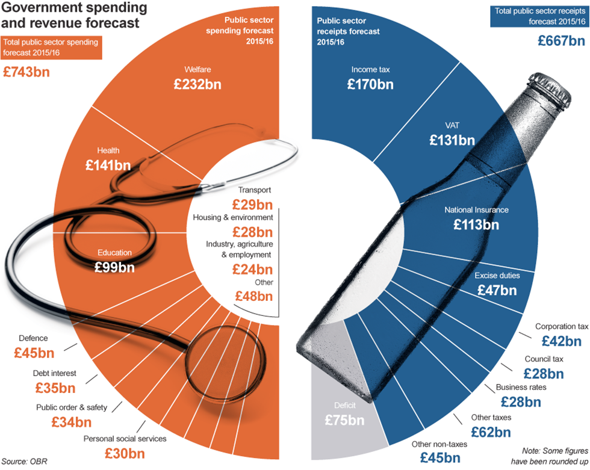
Notes:
NB – slides use the available data which is based on different financial years but give a consistent overall picture. The above slide is 2015/16.
It shows the amount of money which the government raises (in blue), as well as where the money is spent (in orange). The grey area is the difference between the two, ie the budget deficit (which will in turn drive the cost of debt interest which is now the 5th largest area of public spending). It is this figure which has been driving the national policy on austerity.
Health is the 2nd highest category of public spending after Welfare. Clearly spending on health has been prioritised by the Government, but the increase in spending is still at historically low levels.

Slide 3
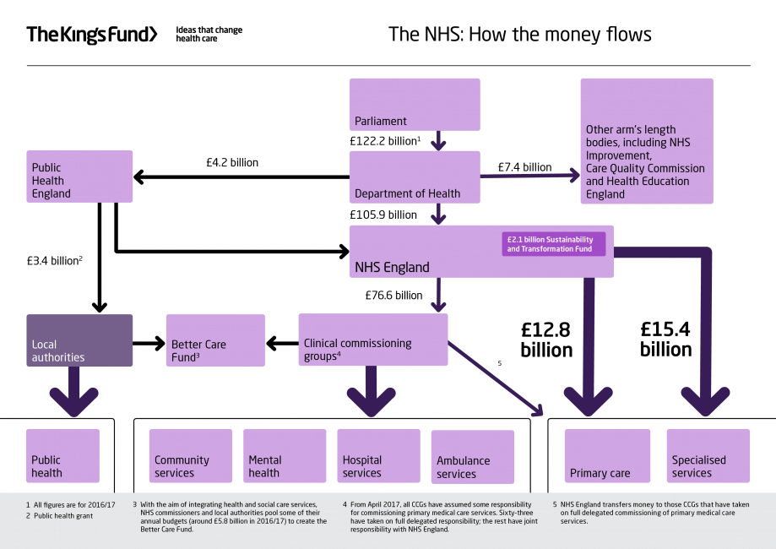
.
Notes:
This slide is 16/17 information.
Health funding like all public sector funding is voted on by Parliament – hence the ultimate requirement “not to bust the vote”
Health funding initially goes to Department of Health who retain a proportion for its functions and then distributes funding to various bodies such as Public Health England and NHS England (NHSE).
In 16/17 NHSE received around £106 billion (£114 billion in 2018/19), along with a mandate setting out the purposes for which the funding can be used.
In 16/17, NHSE retained £29bn (£38bn by 18/19) to pay for its running costs and the services it commissions directly: primary care (including non delegated GP services), specialised services, offender and military healthcare.
The remaining £76bn is passed on to Clinical Commissioning Groups (CCGs) to enable them to commission services for their populations. It’s NHSE’s Board who determine how much each CCG will be funded based on a funding formula and options.

Slide 4
CCG Allocations
CCGs receive 2 separate allocations – programme and running cost allowance
Sheffield 2018/19 allocations:
Programme (healthcare) £869m (£1,450 per registered patient) – this includes primary care co-commissioning
Running Cost Allowance (admin) £12.7m
Allocations for programme and primary care co-commissioning are determined with reference to a national funding formula, based on population size, age/sex distribution, deprivation. CCGs who are deemed to spend more than their ‘fair share’ receive lower growth uplift than those who are under target.
As at March 2019, Sheffield CCG is expected to be 5.4% above its CCG target allocation and 0.2% above its Primary Medical target allocation.
Notes:
The position against target determines how much each CCG gets of the funding that NHS England decides is available to distribute to CCGs. Because we are more than 5% higher than our target allocation, this means we receive a lower cash uplift than the majority of other CCGs – see next slide

Slide 5
NHS Bedford received 3.4%
Sheffield CCG's cash uplift was 1.6%, £4m lower than if received average
Sheffield CCG's cash uplift was 1.6%, £4m lower than if received average
National average CCG cash uplift was 2.1%
Notes:
The difference between the 1.6% cash uplift that Sheffield received in 2017/18 and the average for all CCGs was £4m.
If we had received 3.4% growth, we would have got £13m more.
The national requirements are no different for Sheffield even though we get less growth – the expectation is that we should be able to identify efficiencies in our baseline spend to deliver improvements.

Slide 6
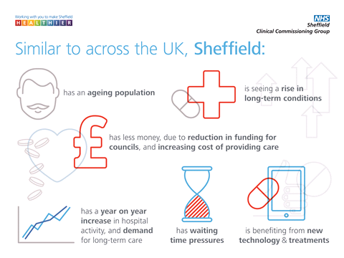
Notes:
In Sheffield, all parts of the system: the Hospitals, General Practice, the Council and the CCG are facing significant challenges. Strangely this means that we all have an interest to find joint solutions to make the system more efficient, as no one part of the system feels able to ‘go it alone’

Slide 7
Where we spent our money in 2017/18
Notes:
Just under half of our £853m gross expenditure related to acute hospital care (£417m), of which £347m related to STHFT.
Primary & Community (£88m primary care, £70m community care)
Mental Health & LD – of £85m, £76m related to SHSCT
Long term care – CHC & Support to social care
Collaborative working – host for ICS, ACP, BCF Programme team

Slide 8
Different Care Costs
Cost of a cataract operation
Varies from £233 (simple) to £1373 (complex)
Cost of a normal birth with no complications
£1,957
Cost of a hip replacement which meets best practice standards
£5,493 (£4,944 if not all quality standards are met)
Cost of an emergency admission for asthma
£1,184. Asthma UK says around 75% of hospital admissions for asthma are avoidable. Asthma affects one in every 12 adults and one in every 11 children. Someone might need emergency help if their usual inhaler treatment isn’t working, some people may need oxygen, steroids intravenous or specialist medications.
Amount we spend on GP registration for each person per year
£87.92. This is the average amount that your GP practice is paid for every registered patient for a year.
Amount we spend on Paracetamol per year
£1.1m. A prescription for paracetamol can cost the NHS up to £3.60 whilst a small packet of paracetamol can be bought for as little as 16p in a shop
Notes:
Costs 18/19 tariff
Global sum amount for GP registration is 18/19
Spend on paracetamol not been update for a couple of years

Slide 9
Primary Care Funding - Delegated
Delegated from NHS England £72m
Core Contract: Payments are made according to the number of patients registered with a practice, and are calculated using the Carr-Hill formula (which takes into account issues such as age and deprivation)
Premises: GP receive reimbursement for the provision of premises to the NHS, incl. rent & rates
Quality Outcomes Framework (QOF): The QOF rewards practices for the provision of 'quality care' and helps to fund further improvements in the delivery of clinical care. Payments are linked to the achievement of a range of indicators
Other GP Services: Specific payments eg locum cover
Enhanced Services: Enhanced services (ES) require an enhanced level of provision above what is required under core GMS contracts. Includes things such as extended access and flu vaccinations

Slide 10
Primary Care Funding – CCG funded
Funded from CCG allocation £20m
Locally Commissioned Services £8.7m: (LCS) are additional services commissioned by CCG to address local priorities, including for example anticoagulation monitoring, neighbourhood developments, enhanced care in to nursing homes.
Other Primary Care £8.1m : Includes spend on GP Hubs, GP IT and Interpreting Services
GP Five Year Forward View Investments £3.3m : Investment to support delivery of the 5 year forward view strategy for general practice, including the development of primary care at scale, and transformation support

